Slide 1
TypeScript
3WEBD

Slide 2
3WEBD – TypeScript
Course Objectives
By the end of the course, students should:
Understand the use case of TypeScript
Be able to setup a TypeScript project
Use TypeScript with React
Time:
course: 2h
exercises: 2h

Slide 3
Summary
TypeScript Introduction
TypeScript Basics
React with TypeScript

Slide 4
1. TypeScript Introduction

Slide 5
1. TypeScript Introduction
TypeScript is a programming language developed and maintained by Microsoft.
It is a strict syntactical superset of JavaScript, adding optional static typing to the language.
TypeScript is designed for development of large applications and transpiles to JavaScript. Since it is a superset of JavaScript, any valid JavaScript code is also valid TypeScript code.

Slide 6
1. TypeScript Introduction
Static Type Checking: TypeScript provides static type checking, meaning types are checked during compile time. This helps catch errors early in the development process, improving code quality and reliability.
Type Inference: TypeScript can infer types from your code, making it less verbose and easier to read. This means you don't always have to explicitly define types, although it's recommended for better code documentation and reliability.

Slide 7
1. TypeScript Introduction
Type Annotations: Developers can annotate variables, functions, and properties with types, making the code intentions clear and the program easier to understand and debug.
Interfaces and Classes: TypeScript supports modern JavaScript features, including classes and interfaces, which are powerful tools for structuring your code and defining contracts within your code.

Slide 8
1. TypeScript Introduction
Advanced Types: TypeScript offers advanced types not available in regular JavaScript, such as enums, tuples, and generics. These types enable more flexible and powerful ways to work with functions and collections.
Compatibility with JavaScript: TypeScript is compatible with JavaScript, meaning you can use existing JavaScript code, incorporate popular JavaScript libraries, or call TypeScript code from JavaScript.

Slide 9
1. TypeScript Introduction
Tooling Support: TypeScript has excellent tooling support with intelligent code completion, type checking, and refactoring available in many code editors and IDEs. This enhances developer productivity and code quality.

Slide 10
1. TypeScript Introduction
TypeScript is now an integral part of the JavaScript ecosystem, both on the frontend side but also on the backend.
All survey show that more than 60% of new projects are starting with a TypeScript configuration hence the technology being central and a knowledge to acquire.
Of course, React supports TypeScript as a default technology - and this is the recommended way to use it.

Slide 11
1. TypeScript Introduction
Using TypeScript offers several significant advantages over plain JavaScript, especially for larger projects or projects that require a high level of reliability and maintainability.

Slide 12
1. TypeScript Introduction
Early Error Detection: One of the most compelling reasons to use TypeScript is its ability to catch errors early in the development process. With static typing, developers can catch mistakes such as type mismatches, incorrect function arguments, and undeclared variables during compilation, long before the code is executed or deployed.
Improved Code Quality: TypeScript's strict typing system encourages more defined and structured code, which can lead to fewer runtime errors. This typing system also makes the code more predictable and easier to debug.

Slide 13
1. TypeScript Introduction
Enhanced Developer Experience: Many integrated development environments (IDEs) and text editors offer better support for TypeScript, providing features like autocompletion, type checking, and inline documentation. This can significantly speed up the development process and improve productivity.
Easier Refactoring: Refactoring code is safer and easier with TypeScript. The compiler can quickly spot errors that might be introduced during the refactoring process, such as incorrect variable types or missing methods, which can be overlooked in plain JavaScript.

Slide 14
1. TypeScript Introduction
Scalability: TypeScript is designed for the development of large applications. Its features like interfaces, generics, and modules make it easier to organize and manage large codebases. This makes TypeScript an excellent choice for teams and projects aiming for long-term growth and scalability.
Rich Type System: TypeScript's type system is powerful and flexible, supporting advanced types like enums, tuples, generics, and union/intersection types. These features allow for more precise definitions and operations, making the code more robust and expressive.

Slide 15
1. TypeScript Introduction
Community and Ecosystem Support: TypeScript has gained widespread adoption and support from the developer community. Many popular libraries and frameworks offer TypeScript type definitions, making it easier to integrate TypeScript into existing projects. The strong ecosystem ensures that developers have access to a wealth of resources, tools, and community support.
Compatibility with JavaScript: Because TypeScript is a superset of JavaScript, any valid JavaScript code is also valid TypeScript code. This allows for incremental adoption, meaning that projects can gradually migrate to TypeScript at a pace that suits them. It also means that teams can use all the JavaScript libraries and tools they are familiar with.

Slide 16
1. TypeScript Introduction
Improved Collaboration: TypeScript's type annotations and compile-time checks can serve as a form of documentation, making it easier for new team members to understand the codebase. This improves collaboration within teams, especially in larger projects where understanding the flow of data and types is crucial.
Better for Large Teams: TypeScript's features can be particularly beneficial for larger teams, where the codebase is more complex, and changes are frequent. The static typing helps ensure that changes by one developer don't unintentionally break functionality elsewhere in the application.

Slide 17
1. TypeScript Introduction
TypeScript enhances the development of JavaScript applications by providing tools and features that help catch errors early, improve code quality, and facilitate better team collaboration.
Its adoption can lead to more maintainable and scalable applications, making it a preferred choice for many developers and organizations.

Slide 18
1. TypeScript Introduction
While TypeScript offers many advantages, especially for large-scale application development, it's important to consider its limitations and potential issues.
Learning Curve: For developers new to TypeScript or static typing, there can be a significant learning curve. This is especially true for those who are only familiar with dynamically typed languages like JavaScript.

Slide 19
1. TypeScript Introduction
Additional Development Time: Writing TypeScript requires more upfront effort compared to JavaScript. Defining types and interfaces adds an additional layer of complexity which can slow down the initial development process.
Compilation Overhead: TypeScript needs to be compiled into JavaScript, which adds an extra step in the development process. This can be a hurdle, especially in projects where quick prototyping is required.

Slide 20
1. TypeScript Introduction
Potentially Verbose: TypeScript's type annotations and interfaces can make the code more verbose. This could lead to longer code for what would be shorter in plain JavaScript, potentially affecting readability and maintainability.
Community Divisions: TypeScript, being a superset of JavaScript, has created some division within the development community. Some developers feel that it complicates what is essentially a simple and flexible language (JavaScript).

Slide 21
1. TypeScript Introduction
Overconfidence in Type Safety: TypeScript's static typing can lead to a false sense of security. While it does catch many type-related errors at compile time, it's not a silver bullet for all bugs. Runtime errors can and do still occur.
Tooling and Build Process Complexity: Integrating TypeScript into build processes and toolchains can add complexity. Configuring compilers, linters, and other tools to work with TypeScript might require additional setup and maintenance.

Slide 22
1. TypeScript Introduction
Performance Considerations: Although TypeScript compiles down to JavaScript, the added complexity of types can sometimes lead to less optimal code compared to hand-optimized JavaScript, especially if not used carefully.
Evolving Language: TypeScript is still evolving, with frequent updates and changes. This rapid evolution can be a double-edged sword, introducing new features but also potentially causing breaking changes or requiring regular updates to codebases.

Slide 23

Exercises

Slide 24
2. TypeScript Basics

Slide 25
2. TypeScript Basics
A type is a representation of a value we use in our program. Types do exist in JavaScript (basic primitive types):
Null
Undefined
Boolean
Number
BigInt
String
Symbol

Slide 26
2. TypeScript Basics
But you don’t have ways to create new types!
TypeScript adds a very rich type system on top of the types that JavaScript provides.
It’s much more efficient for the TypeScript compiler to catch errors than to have things fail at runtime. Types also inform the developer about the values a program is expected to deal with without running the code.

Slide 27
2. TypeScript Basics
We only have a few useful types in JavaScript.
JavaScript does not have the capability to declare that a variable is of a particular type.
Instead, the type is inferred from the value it is assigned.
There is no strict type checking in JavaScript either, which means that a variable can be changed to hold any value. In loosely typed languages, you don't have to specify types of variables. JavaScript is loosely typed.

Slide 28
2. TypeScript Basics
TypeScript type annotations allow us to assign types to variables.
The syntax for a type annotation is to put a colon followed by the type after the variable name before any assignment.
We can add type annotations to function parameters as well as to its return value.
The syntax for a type annotation on a parameter is just like type annotations on variables - a colon followed by the type is added after the parameter name.
We can also add a type annotation for the return value by adding a colon followed by the type after the function's parentheses.

Slide 29
2. TypeScript Basics
In JavaScript, there is no type checking process requiring function callers to pass all the defined parameters.
In TypeScript if you don’t provide all parameters, the type error is raised. TypeScript expects the function parameters that have been defined to be passed to it.
There is a way to make function parameters optional in TypeScript. We can define that a parameter is optional by putting a question mark before the colon.
It is important to note that optional parameters can only be at the end of the parameter list.

Slide 30
2. TypeScript Basics
TypeScript doesn’t exist at runtime - it is a development tool. So, TypeScript won't do any type checking on the code at runtime.

Slide 31
2. TypeScript Basics
Adding type annotations to our code is extra code we need to write, which consumes a little more of our time and bloats our code. TypeScript has something called type inference, which means, in many cases, it can work out a variable's type without it having a type annotation.
TypeScript will automatically infer the type for a variable if a type annotation hasn't been specified.

Slide 32
2. TypeScript Basics
TypeScript infers the type of a string constant to the value of the constant rather than the wider string type.
This is because a string constant can only be that value. This is called a string literal type.
When a constant is initialized from a primitive type, TypeScript infers it to be a literal type of the specific value assigned.
However, when a constant is initialized from a non-primitive type, TypeScript only infers it to be of the same type as assigned.

Slide 33
2. TypeScript Basics
f there is no assignment in a variable declaration, then TypeScript infers the variable to be of type any.
“any” is the broadest type in TypeScript's type system.
Type inference happens on functions as well.
TypeScript can infer the return type of a function. TypeScript also infers the type of a variable in a declaration where the assignment is from a function.

Slide 34
2. TypeScript Basics
TypeScripts inference breaks down on functions when no type annotations are defined on their parameters.
TypeScript can infer the type of a function parameter if it has a default value.
So, it is best practice to include type annotations for function parameters if they don't have default values.

Slide 35
2. TypeScript Basics
There are some additional standard types that TypeScript has in its type system
Array
Any
Tuples
Date
void
never
unknown

Slide 36
2. TypeScript Basics
1. Date
If we assign a variable to the JavaScript Date constructor, TypeScript infers its type to be Date.
The Date type is a representation of the Date object in JavaScript.
The Date type lets us strongly-type date variables and gain useful intellisense on the JavaScript Date object.

Slide 37
2. TypeScript Basics
2. Any
TypeScript doesn't carry out any type checking on items that have the any type. The any type is a way of opting out of the type checking process.
One of the main reasons for using TypeScript is to enable type checking.
When it isn't possible to create a TypeScript type to represent an item, we can use the any type. Historically, when TypeScripts type system wasn't as powerful, this would be the case every so often. However, today, this case rarely happens.

Slide 38
2. TypeScript Basics
An example where we may see any being used is where we are dealing with dynamic data.
This is data that is defined by end-users rather than developers. The ability for end-users to create custom forms is an example of where code would need to deal with dynamic data.

Slide 39
2. TypeScript Basics
3. Void
The void type represents a function's return type when it doesn't return any data.
The void type can't hold any data - it can only be undefined (or null if the strictNullChecks compiler option is off).

Slide 40
2. TypeScript Basics
4. Array
Another common type we use is arrays. We can find two different methods to create array types.
We can also use the array type to create a strongly typed function Rest parameter.
We can use a type annotation to specify that an array should only contain items of a specific type. There is an Array generic type that we can use to do this.
We can use an array type annotation to strongly-type function rest parameters.

Slide 41
2. TypeScript Basics
5. Tuples
A tuple can be thought of as an array with a fixed number of elements. For example, ome of the hooks in React return tuples.
Tuples are useful when we want to store multiple bits of data. Tuples are a little more concise than an object but aren't as self-documenting as objects. So, tuples are nice for small and obvious data structures.

Slide 42
2. TypeScript Basics
The tuple type doesn't exist in JavaScript. The closest we have are arrays, but there is no way of enforcing the number of elements and each element's type.Typescript can't infer the correct type for fixed tuples.
So, we will always need to use a type annotation for tuples.An issue with tuples is that it isn't obvious what data should be placed in its elements. TypeScript 4.0 eases this problem with the ability to label elements within a tuple.

Slide 43
2. TypeScript Basics
6. Never
The never type is used to represent a type of value that will never occur.
It is useful to explicitly flag areas of code that shouldn’t be reached. It is also useful when creating conditional types,

Slide 44
2. TypeScript Basics
7. Unknown
The unknown type is similar to the any type but is type-safe.
We saw that the any type could be used when we are unsure of the type of value. The problem with any is that no type checks will be carried out on values of type any.
What if there was a type like any that can be used for values we don't know but was also type-safe?
This is what the unknown type is!

Slide 45
2. TypeScript Basics
You can't operate directly on variables of type unknown.
We have to give TypeScript information to narrow the type so that it can be used.
The unknown type allows us to reduce our use of any and create more strongly-typed code. We do write a little more code when using unknown, but the confidence we get from knowing our code is type-safe is well worth it.

Slide 46
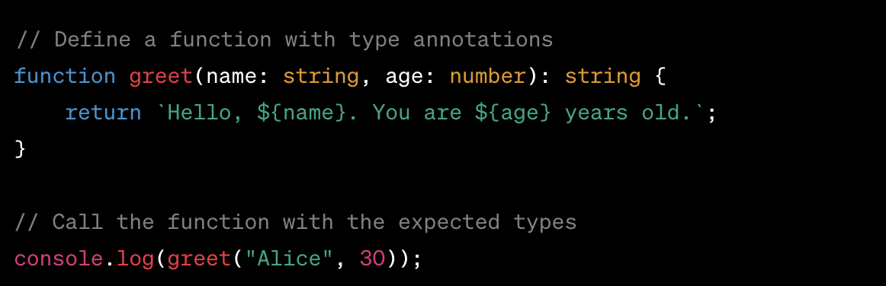
2. TypeScript Basics
Basic type

Slide 47
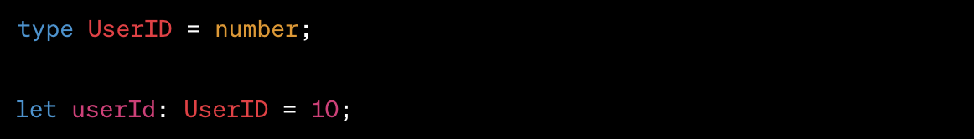
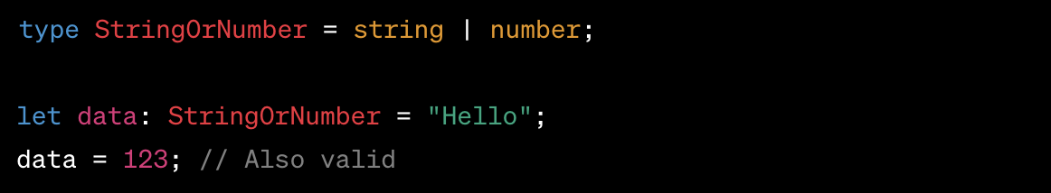
2. TypeScript Basics
Custom type

Slide 48
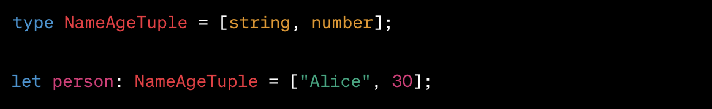
2. TypeScript Basics

Slide 49
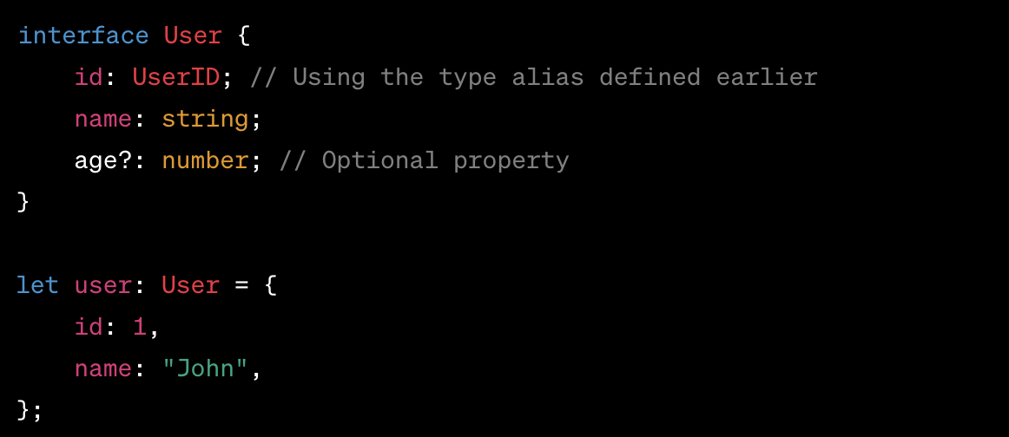
2. TypeScript Basics
Custom types using Interfaces

Slide 50
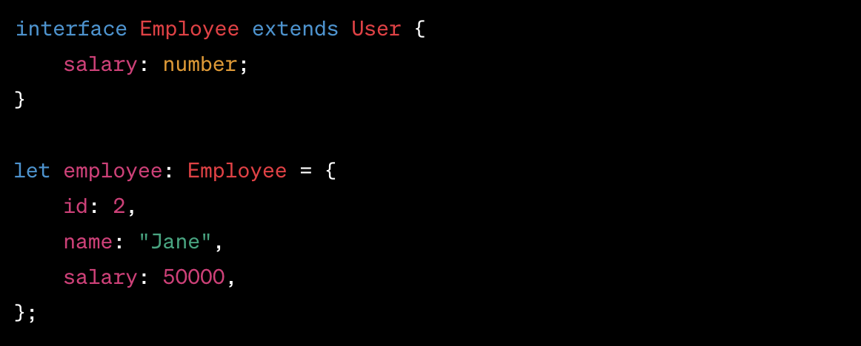
2. TypeScript Basics
Extending interface

Slide 51
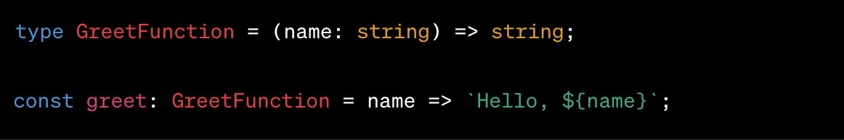
2. TypeScript Basics
Typing a function

Slide 52
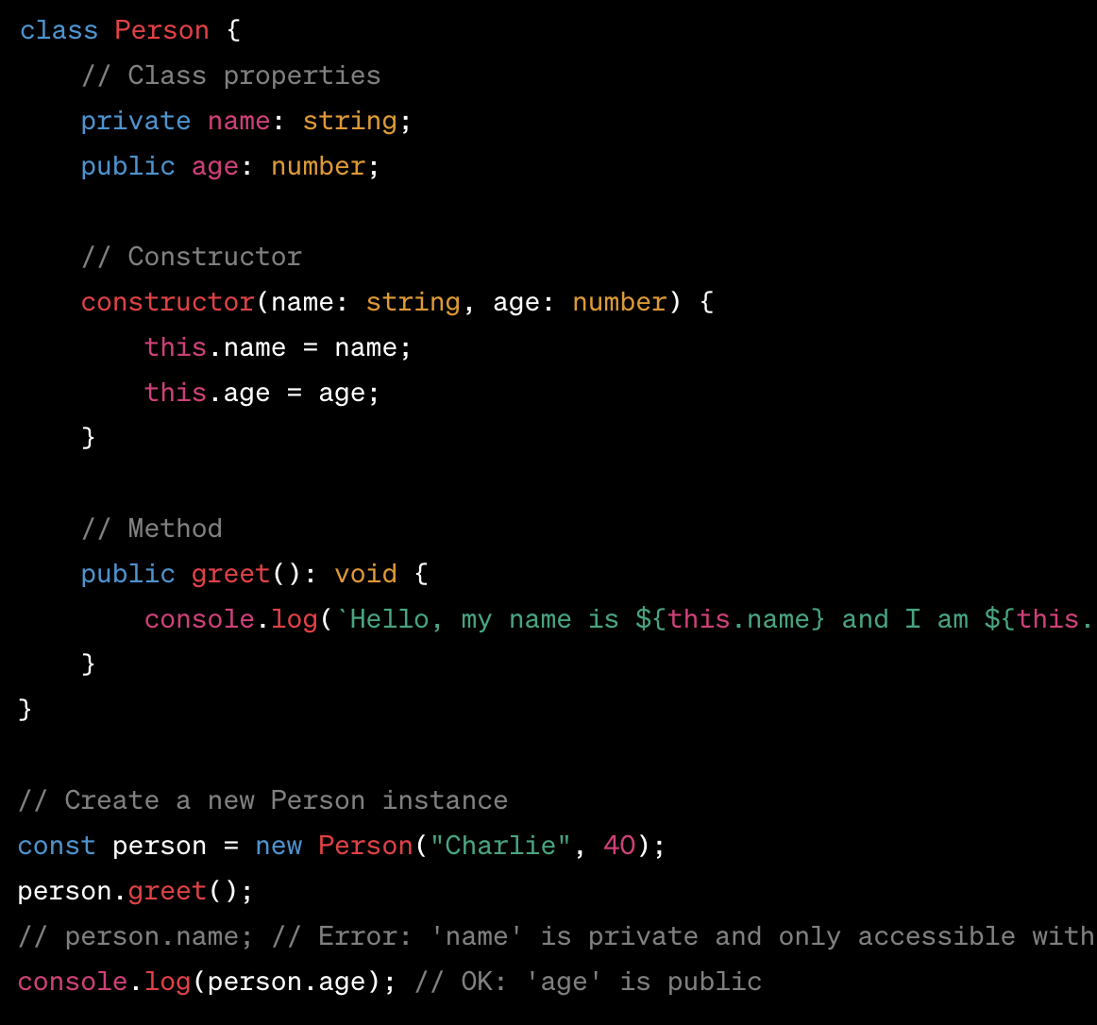
2. TypeScript Basics
Type and classes

Slide 53
2. TypeScript Basics

Slide 54
2. TypeScript Basics
Running a TypeScript file involves two main steps:
compiling the TypeScript (.ts) file into JavaScript (.js) using the TypeScript compiler (tsc)
executing the compiled JavaScript file with Node.js or in the browser.

Slide 55
2. TypeScript Basics
First, you need to have Node.js installed on your system. Then, install TypeScript globally using npm (Node Package Manager). Open your terminal or command prompt and run:
npm install -g typescript

Slide 56
2. TypeScript Basics
Navigate to the directory containing your TypeScript file (let's say it's named example.ts). Run the following command in your terminal to compile the TypeScript file to JavaScript:
tsc example.ts

Slide 57
2. TypeScript Basics
This command generates a JavaScript file (example.js) in the same directory.
The TypeScript compiler (tsc) compiles the .ts file into a .js file based on the rules defined in your tsconfig.json file, if present.
If you don't have a tsconfig.json file, tsc uses default compiler options.

Slide 58
2. TypeScript Basics
After compiling your TypeScript file to JavaScript, you can run the resulting .js file with Node.js. Run the following command in your terminal:
node example.js

Slide 59
Exercises

Slide 60
3. React with TypeScript

Slide 61
3. React with TypeScript
Vite can generate a base React application with TypeScript enabled by default thanks to the “template” option, and selecting “typescript”.
If you already have your base application you can also “migrate” from the JavaScript side to using TypeScript but the manual configuration may be longer than generating a new project.

Slide 62
3. React with TypeScript
Starting now, we will try to follow all best practices during the exercises and use TypeScript to enforce some specific types as this will be the main way you will see React being used.

Slide 63
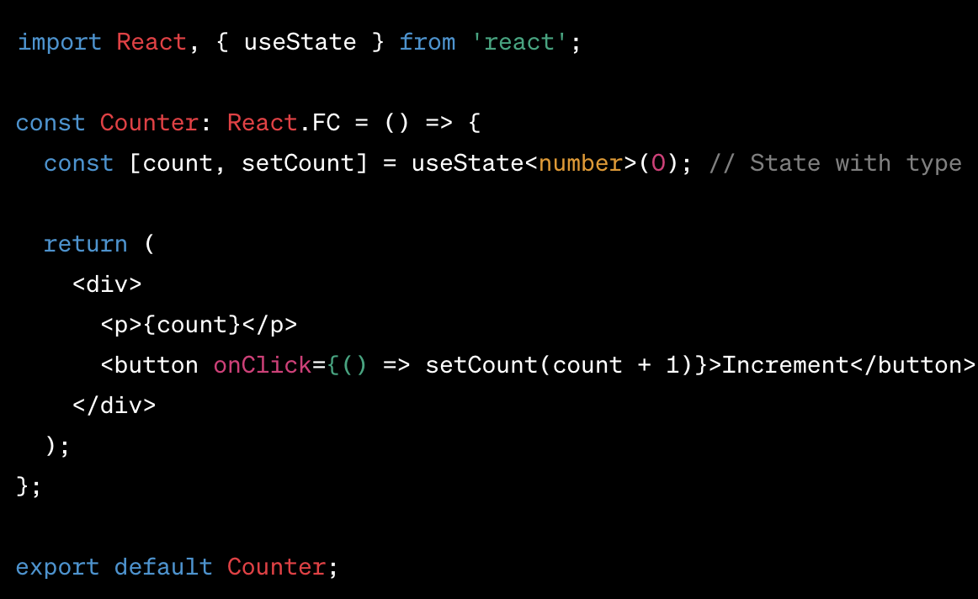
3. React with TypeScript
Example with counter

Slide 64
3. React with TypeScript
In the previous example, we can see that there is not a lot of changes. The main points are
React.FC: it is a Ract type that allow you to type a component
useState<number>(0): it let you say that this state will only be numbers and not some other types.

Slide 65
3. React with TypeScript
One place where you will define types (or interface) will be for props that you will pass between components. A nice solution is to use “PropTypes” to handle it! You can find the package here

Slide 66
Exercises

